Slide 1
PSCS226 - Kisan Buddy
PIP2001 Capstone Project
Review-1
Batch Number: CBC-12
Roll Number | Student Name
20211CBC0044 | K V Achyuth Reddy
20211CBC0055 | Lochan S
20211CBC0052 | Shrusthi
20211CBC0001 | Ediga Purushotham Goud
Under the Supervision of,
Dr./Mr./Ms./Prof. M Swapna
Professor / Associate Professor / Assistant Professor
School of Computer Science and Engineering
Presidency University
Name of the Program: BTech
Name of the HoD: Dr. Pravintha Raja
Name of the Program Project Coordinator: Ms. Suma N G
Name of the School Project Coordinators: Dr. Sampath A K / Dr. Abdul Khadar A / Mr. Md Ziaur Rahman

Slide 2
Introduction
Organization: Mahindra & Mahindra(FarmEq )
Category (Hardware / Software / Both) : Software
Problem Description: Input to the app: Farmer's location, crops that he produces and their cost. This app gives the estimate of the nearest mandi where the farmer can sell his produce in his location . In addition to it, the app estimates the cost for each transaction and also displays the least cost transaction.
Difficulty Level: Simple
This Android-based application helps farmers find the nearest mandi (local market) based on their location using Google Maps.
It estimates the cost of transactions for selling different types of produce and helps farmers choose the mandi with the least transaction costs.
Firebase is used as the backend for data storage, user information, and transaction details.
The app aims to provide a smart solution for small-scale farmers to improve their profit margins by reducing transportation and transaction costs.

Slide 3
Literature Survey
The literature survey section explores existing research and developments related to mobile technology in agriculture, market accessibility, and cost optimization for farmers. By reviewing these studies, we can better understand the limitations of current methods and identify opportunities for improving farmers' connectivity to markets through mobile applications, GIS technology, and cloud-based platforms. This survey forms the foundation for the proposed app’s development, ensuring it addresses key challenges faced by farmers today.
10 research papers that we have referred which cover the following areas are:
Digital Market: E-Commerce Application For Farmers
eMarket for Local Farmers
KRISHI BAZAAR: An E-Commerce Application For Direct Farmer-to-Consumer Trading
Android App to Connect Farmers to Retailers and Food Processing Industry
AGROCART-An Online Platform for Farmers to Sell Products without Middleman
Android App to Connect Farmers to Retailers and Food Processing Industry
SMART KISAN: A Mobile App for Farmers' Assistance in Agricultural Activities
Technology-enabled online aggregated market for smallholder farmers to obtain enhanced farm-gate prices
AGRITECHNO: A Development of a Revolutionized Farmer Assisted Agricultural Product Forecasting Mobile App System
Analysis of mandi systems and market networks in India.

Slide 4
Existing method Drawback
The existing methods for farmers to access markets are often inefficient and costly, relying on outdated practices like middlemen and physical visits to mandis. These approaches result in higher transaction costs and reduced profits. Despite some digital efforts, current solutions lack real-time data and ease of use, underscoring the need for a more efficient, tech-driven approach.
1. Local Market Price Bulletins :Farmers rely on physical notice boards or weekly market bulletins to get information about crop prices at local markets or mandis.
Drawbacks:
i)Delayed Information ii)Lack of Real-Time Data
2. Government Websites and Mobile Apps :Some government agencies provide market price information through websites or apps, such as e-NAM (National Agriculture Market).
Drawbacks:
i)Complexity of Use ii)Incomplete Coverage
3. Agricultural Cooperatives and Unions :Farmers often rely on agricultural cooperatives or unions to sell their produce collectively, which helps negotiate better prices with mandis.
Drawbacks:
i)Limited Autonomy ii)Potential Middlemen Fees
4. Middleman/Broker Networks :Farmers often sell their produce to middlemen who act as brokers between them and the mandis, handling the transaction and logistics.
Drawbacks:
i)High Commission Fees ii)Lack of Transparency

Slide 5
Proposed Method
The proposed method introduces a tech-driven solution to help farmers access markets more efficiently. By using an app with location tracking and real-time data, farmers can easily find the nearest mandi and compare costs, enabling better decision-making and reducing transaction expenses.
The Proposed Methodologies are:
Android App: Farmers can use their mobile devices to input their location and details of their produce.
Google Maps Integration: The app uses Google Maps API to find the nearest mandi from the farmer’s location.
Cost Estimation Algorithm: The app calculates estimated transaction costs for each mandi.
Mandi Comparison: Provides a comparison of transaction costs for various mandis and recommends the least expensive option.
Firebase Backend: Secure storage of user data, crop prices, mandi details, and transaction history.

Slide 6
Objectives
The objectives aim to create an app that helps farmers find nearby mandis, compare transaction costs, and choose the most cost-effective option, improving their market access and profitability.
=>Main Objectives are :
To develop an Android application that helps farmers locate the nearest mandi using GPS and Google Maps.
To estimate the transaction costs for each mandi based on the farmer's produce and quantity.
To recommend the mandi with the lowest transaction cost for the farmer.
To utilize Firebase as the backend for storing mandi data, crop information, and transaction history.
To offer a simple, user-friendly interface for farmers, ensuring ease of access and utility.

Slide 7
Methodology/Modules
The modules/methodology section describes the app's key components, including location services and cost estimation, to enhance functionality. This approach ensures easy navigation and effective decision-making for farmers.
The Modules used are:
Location-Based Mandi Search :
Uses Google Maps API to locate the nearest mandi.
Displays mandi details and distance from the farmer's location.
Crop and Transaction Cost Input :
Farmers input the type and quantity of crops.
The app calculates transportation and mandi fees.
Cost Comparison and Recommendation:
Compares transaction costs across mandis.
Suggests the least expensive mandi for the farmer.
Firebase Integration:
Data storage for mandi details, crop prices, and transaction histories.
User authentication and secure access to stored information.

Slide 8
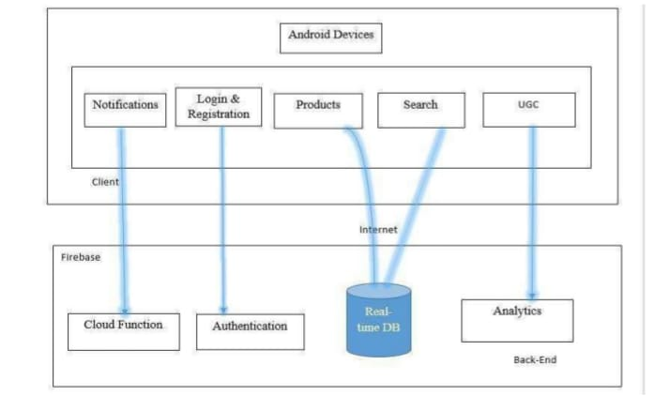
Architecture

Slide 9
Hardware/software components
Hardware Requirements:
Android device with GPS capability.
Internet connectivity.
Software Requirements:
Android Studio: For app development.
Google Maps API: For location services.
Firebase: Backend for user data, crop prices, and mandi details.
Java/Kotlin: Programming language for Android development.

Slide 10
Timeline of Project
 | Month 1 |  |  | Month 2 |  |  |  | Month 3
Task | Week 1 | Week 2 | Week 3 | Week 4 | Week 5 | Week 6 | Week 7 | Week 8 | Week 9 | Week 10
1. Project Planning
2. Front End Development
3. Back End Development
4. Testing & QA
5. Deployment & Launch
11 Sept 18 Sept 9 Oct 31 Oct 14 Nov 22 Nov

Slide 11
Expected Outcomes
These could be the expected outcomes for the project:
Improved Market Access: Farmers will be able to easily locate the nearest mandis, enhancing their ability to sell produce efficiently.
Cost Reduction: The app will provide accurate transaction cost estimates, enabling farmers to select the most cost-effective options and reduce expenses.
Informed Decision-Making: Access to real-time data will empower farmers to make better decisions regarding where and when to sell their crops.
Increased Profitability: By minimizing transportation and transaction costs, farmers can potentially increase their overall profit margins.
User-Friendly Experience: A simple interface will encourage more farmers to adopt the technology, bridging the digital divide in agricultural practices.
Data-Driven Insights: The collection of market data will provide insights into pricing trends, helping farmers plan their sales strategies more effectively.

Slide 12
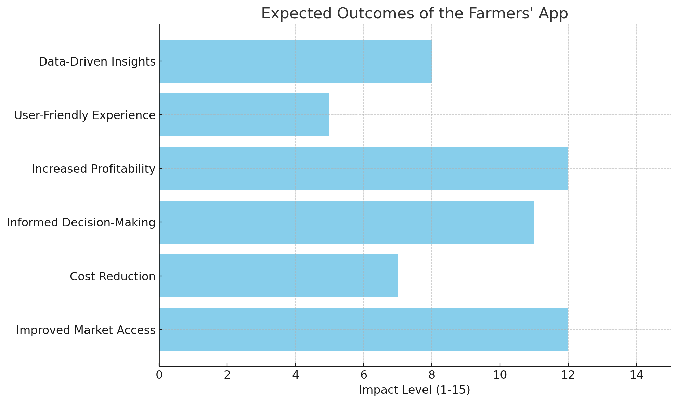
Expected Outcomes

Slide 13
Conclusion
The conclusion section summarizes the key insights and implications of the project, emphasizing its significance in transforming market access for farmers. By integrating technology into traditional agricultural practices, the app aims to empower farmers and enhance their profitability.
Here’s a conclusion on our application:
The proposed app enhances market access for farmers through a user-friendly, tech-driven solution.
It utilizes real-time data and location services to help farmers find nearby mandis and estimate transaction costs.
The app addresses inefficiencies and challenges of traditional agricultural practices.
Expected outcomes include improved profitability and reduced expenses for farmers.
The project empowers farmers and contributes to the growth and sustainability of agricultural markets.

Slide 14
Github Link
GitHub Link
https://github.com/PSCS226/Kisan-Buddy---PSCS226

Slide 15
References
Here are the articles which we referred :
[1] Mrs. Manisha Bhende , Ms. Mohini S. Avatade, Mrs. Suvarna Patil, ” Digital Market : E-Commerce Application For Farmers”,2015.
[2] Aina Marie Joseph; Nurfauza Jali; Amelia Jati Robert Jupit; Suriati Khartini Jali “eMarket for Local Farmers” ,2021.
[3] Vaishnavi Desai; Isha Ghiria; Twinkle Bagdi; Sanjay Pawar, “KRISHI BAZAAR: An E-Commerce Application For Direct Farmer-to- Consumer Trading“, 2022.
[4] Pranav Shriram; Sunil Mhamane, “Android App to Connect Farmers to Retailers and Food Processing Industry“, 2020.
[5] Tejal Yadav; Pooja Sable; Dhananjay Kalbande, “SMART KISAN: A Mobile App for Farmers' Assistance in Agricultural Activities“, 2023.
[6] Malni Kumarathunga; Rodrigo Calheiros; Athula Ginige, “Technology-enabled online aggregated market for smallholder farmers to obtain enhanced farm-gate prices“, 2021.
[7] Joe Marie D. Dormido; Alvin R. Malicdem, “AGRITECHNO: A Development of a Revolutionized Farmer Assisted Agricultural Product Forecasting Mobile App System”,2020.
[8] Faria Soroni; Md. Amdadul Bari; Mohammad Monirujjaman Khan, “GERAM BAZAR, A Mobile Application and Website Interface E-commerce“ , 2021.

Slide 16

Project work mapping with SDG

Slide 17
Thank You

